Slide 1

Advancements in the field of Automated unit testing

Slide 2
New technologies
The field of automation testing has evolved not just to include testing but also incorporated various other fields.
1. AI
2. Machine learning
3. Deep learning

Slide 3
How AI/ML enhances test case automation
AI-powered Visual Validation tools
The key objective of image-based visual validation is to ensure that the UI appears correctly to the user. Which could not be done with older unit test software's. ML-powered visual validation tools help to automate these since ML can recognize patterns.[1]
API testing:
Machine learning algorithm boil down the testing to just backend which makes it easier to test any piece of code. [1]
Automated running of test cases depending on code change
AI/ML algorithms have superior analytics capabilities; therefore, you can find out what is the minimum set of test cases you should run to test a small change to the code. [1]
Creating test cases.
AI/ML algorithms can “read” your application and learn about it. These algorithms build a data set that contains observations about your application, including how its various features should behave given certain conditions. [1]

Slide 4
Relation to the experiment
The application Diffblue was successfully able to perform below tasks which could not be performed in the earlier versions of test automation tools.
Creation of Negative scenarios
Creation of black box scenarios
Creation of white box scenarios.

Slide 5


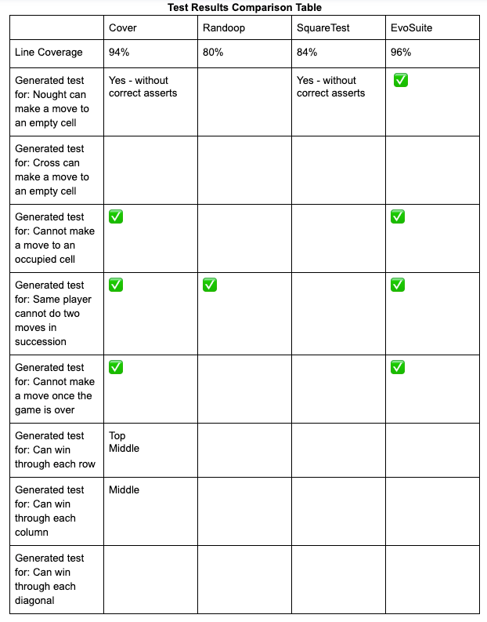

Comparison between Randoop, evosuite and Diffblue(cover)
The table has been taken from the official website of diffblue(cover) [3].
Comparing the results achieved by our experiment and the results given on the website we can conclude that our experiment results correspond to the behavior which has been reported on the official website.
Which is : “AI based tools not only create a higher number of test cases but also a higher quality of test cases which have a better coverage.”

Slide 6
References
[1] https://testsigma.com/blog/can-ai-driven-test-automation-enhance-test-automation/
[2] https://www.parasoft.com/what-is-artificial-intelligence-in-software-testing/
[3] https://www.diffblue.com/blog/java/testing/java-unit-test-generator-comparison-diffblue-cover-vs-evosuite-vs-randoop-vs-squaretest/

